Slide 1
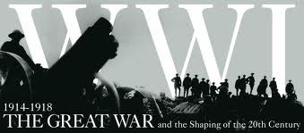
Picture Analysis Activity

Slide 2
Photo 1
This image shows French soldiers on the front lines

Slide 3
Photo 2
This image shows British machine gunners in action in 1916 wearing gas helmets for protection from poison gas

Slide 4
Photo 3
In this image we see British soldiers huddled in a trench between bombing raids in 1916

Slide 5
Photo 4
In this image we see soldiers passing the time in a trench

Slide 6
Photo 5
In this image we see British soldiers ready to attack from a trench

